Slide 1

Graph

Slide 2
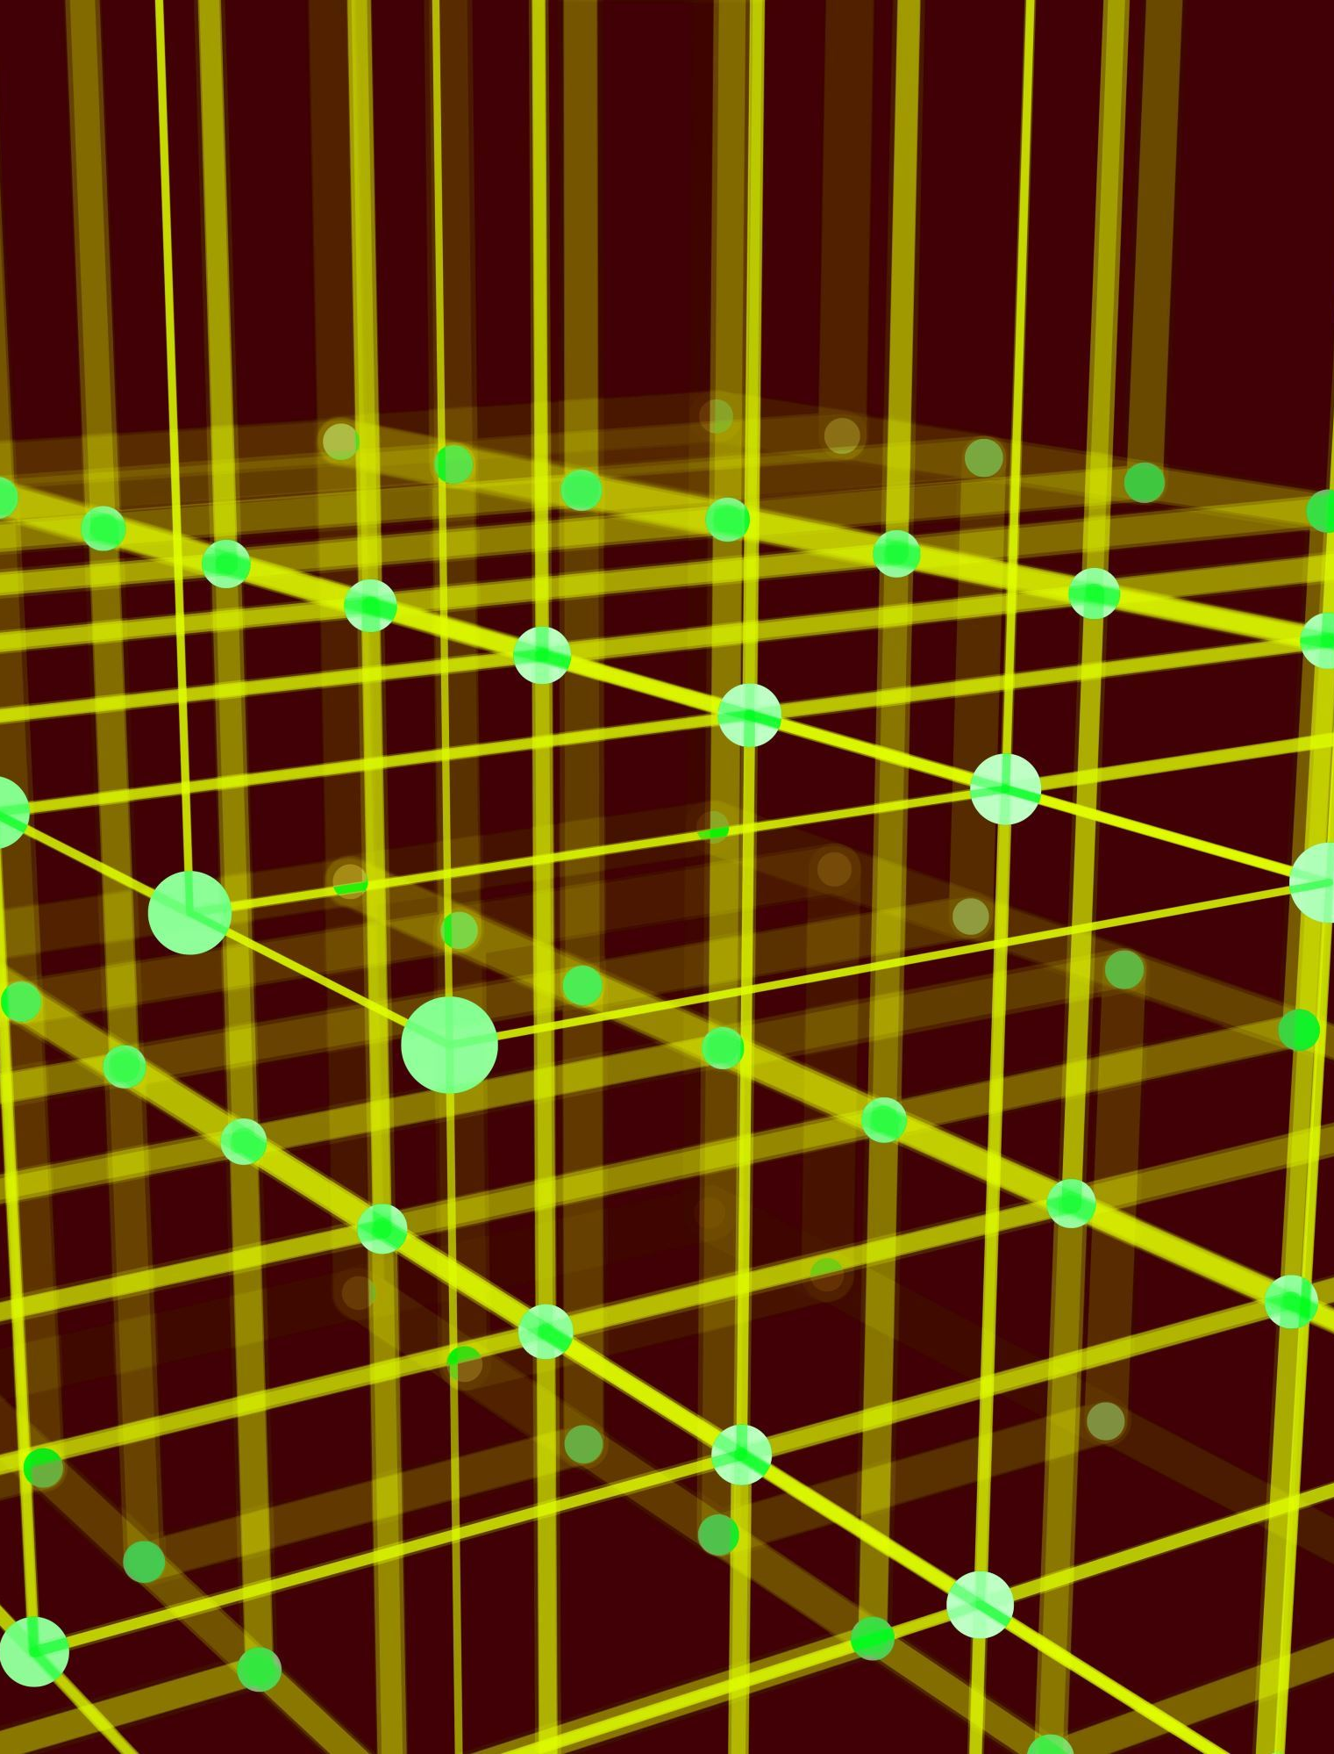
Graph
Graph is a non-linear data structure consisting of vertices and edges.
The vertices are sometimes also referred to as nodes and the edges are lines or arcs that connect any two nodes in the graph.
More formally a Graph is composed of a set of vertices( V ) and a set of edges( E ). The graph is denoted by G(E, V).
V(G) represents the set of vertices and E(G) represents the set of edges which are used to connect these vertices.

Slide 3
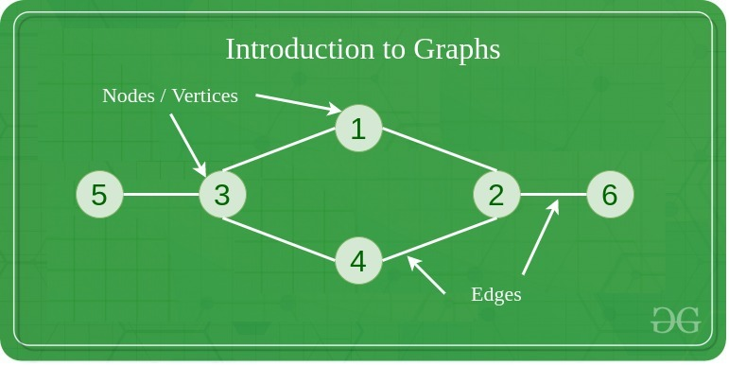
Graph

Slide 4
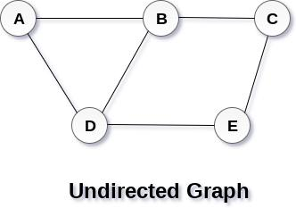
Graph
Graph G(V, E) with 5 vertices (A, B, C, D, E) and six edges ((A,B), (B,C), (C,E), (E,D), (D,B), (D,A)) is shown in the following figure.

Slide 5
Directed Graph and Undirected Graph
undirected graph, edges are not associated with the directions with them. If an edge exists between vertex A and B then the vertices can be traversed from B to A as well as A to B.
directed graph, edges form an ordered pair. Edges represent a specific path from some vertex A to another vertex B. Node A is called initial node while node B is called terminal node.

Slide 6
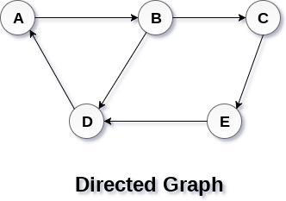
Directed Graph and Undirected Graph

Slide 7
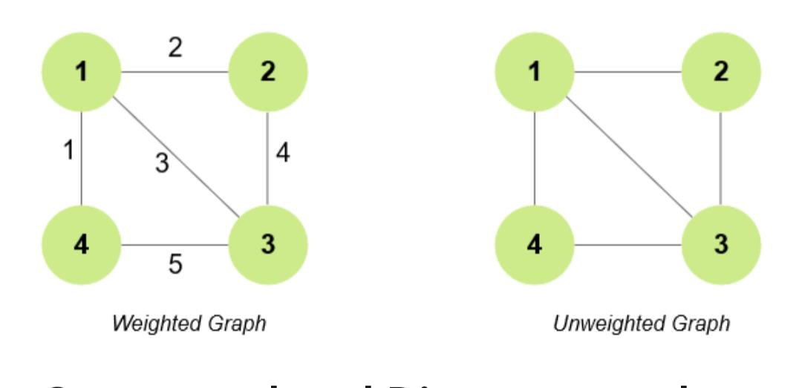
Weighted graph and Unweighted graph
Weighted graph: There is some weight over the edges of the graph.
Unweighted graph: There is no weight over the edges of the graph

Slide 8
Graph Terminology
path can be defined as the sequence of nodes that are followed in order to reach some terminal node V from the initial node U.
path will be called as closed path if the initial node is same as terminal node.
cycle can be defined as the path which has no repeated edges or vertices except the first and last vertices.
degree of a node is the number of edges that are connected with that node. A node with degree 0 is called as isolated node.
Adjacency: A vertex is said to be adjacent to another vertex if there is an edge connecting them.

Slide 9
Adjacency Matrix
Adjacency matrix is a sequential representation. It is used to represent which nodes are adjacent to each other. i.e. Is there any edge connecting nodes to a graph. In this representation, we have to construct a nXn matrix A. If there is any edge from a vertex i to vertex j, then the corresponding element of A, ai,j = 1, otherwise ai,j= 0.

Slide 10
Representation of Graph
a graph representation is a technique to store graph into the memory of computer.
To represent a graph, we just need the set of vertices, and for each vertex the neighbors of the vertex

Slide 11
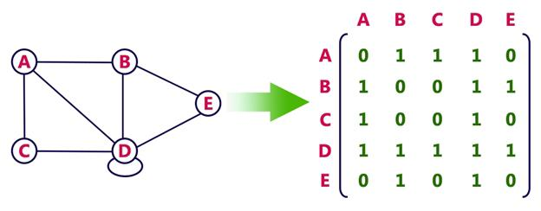
Undirected Graph

Slide 12
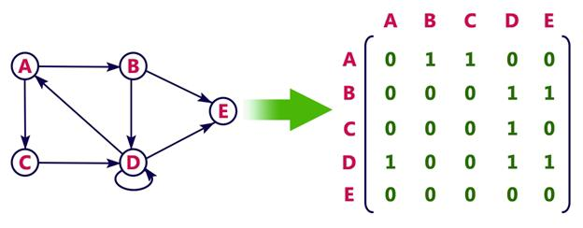
Directed Graph

Slide 13
Adjacency list
Adjacency list is a linked representation. In this representation, for each vertex in the graph, we maintain the list of its neighbors. It means, every vertex of the graph contains list of its adjacent vertices. We have an array of vertices which is indexed by the vertex number and for each vertex v, the corresponding array element points to a singly linked list of neighbors of v.

Slide 14
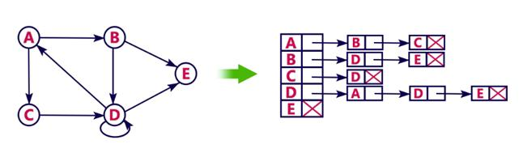
Adjacency list

Slide 15
Traversing a Graph
Traversing or searching is one of the most used operations that are undertaken while working on graphs.
stands for Breadth First Search. It is also known as level order traversal. The Queue data structure is used for the Breadth First Search traversal. When we use the BFS algorithm for the traversal in a graph, we can consider any node as a root node.
. It is a recursive algorithm to search all the vertices of a tree or graph data structure. BFS puts every vertex of the graph into two categories - visited and non-visited. It selects a single node in a graph and, after that, visits all the nodes adjacent to the selected node.

Slide 16
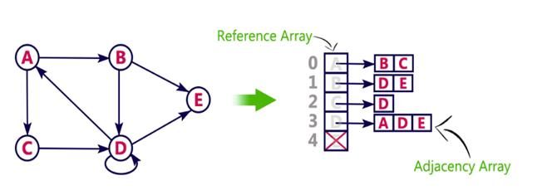
Adjacency list

Slide 17
Traversing a Graph
To implement such an order, you use a queue data structure which First-in, First-out approach.

Slide 18
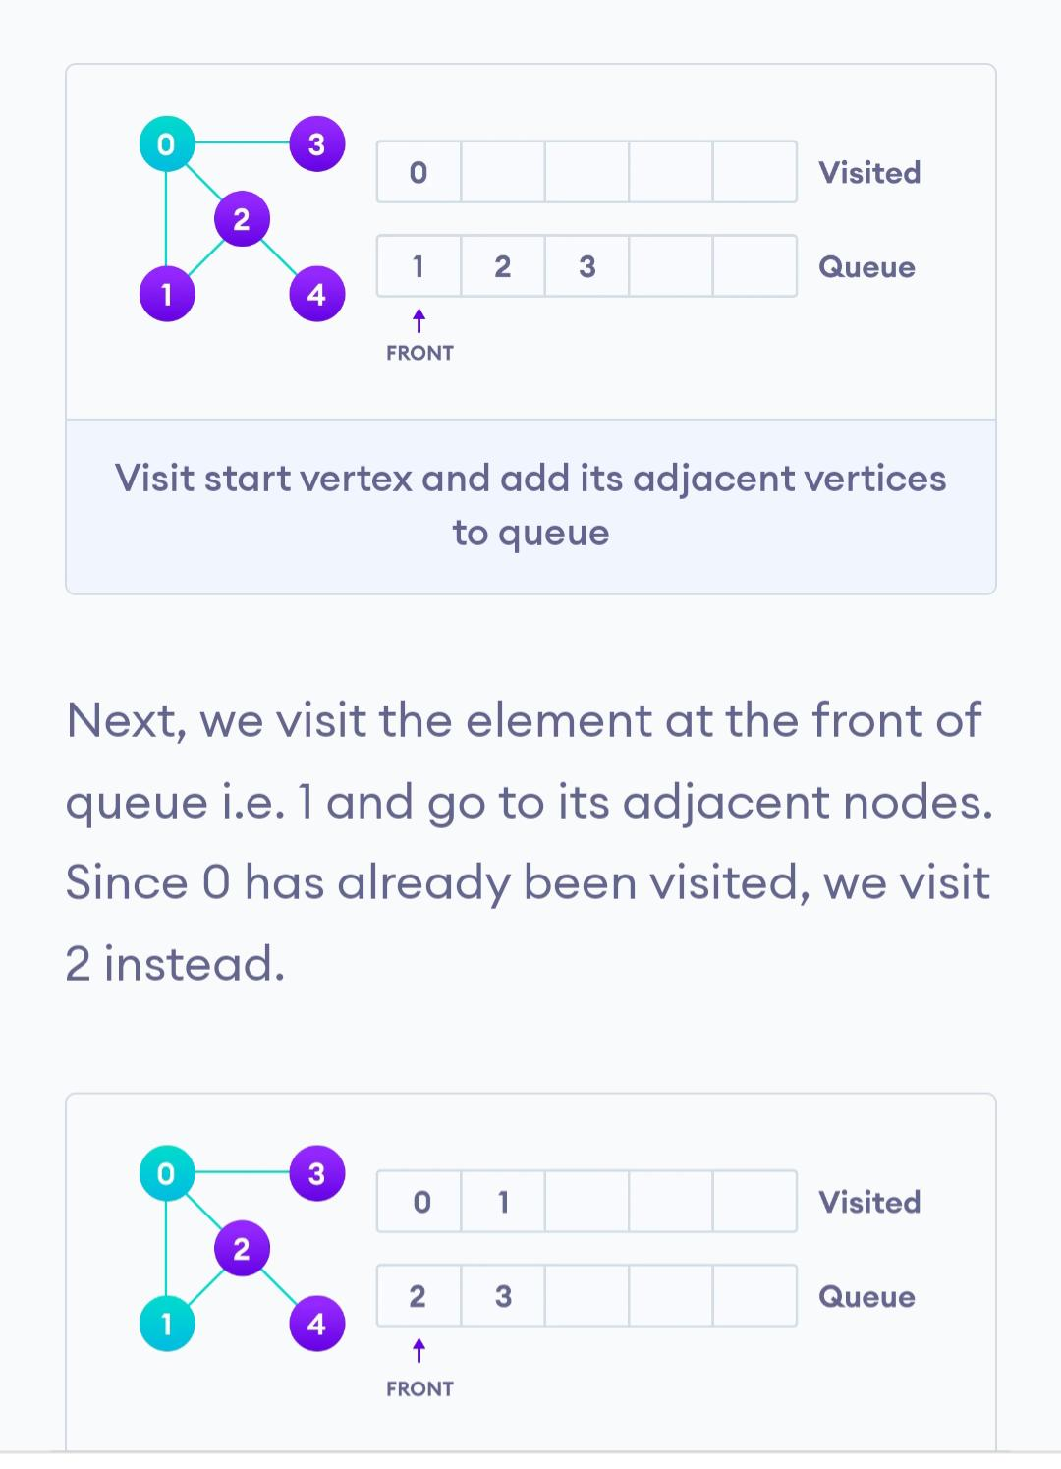
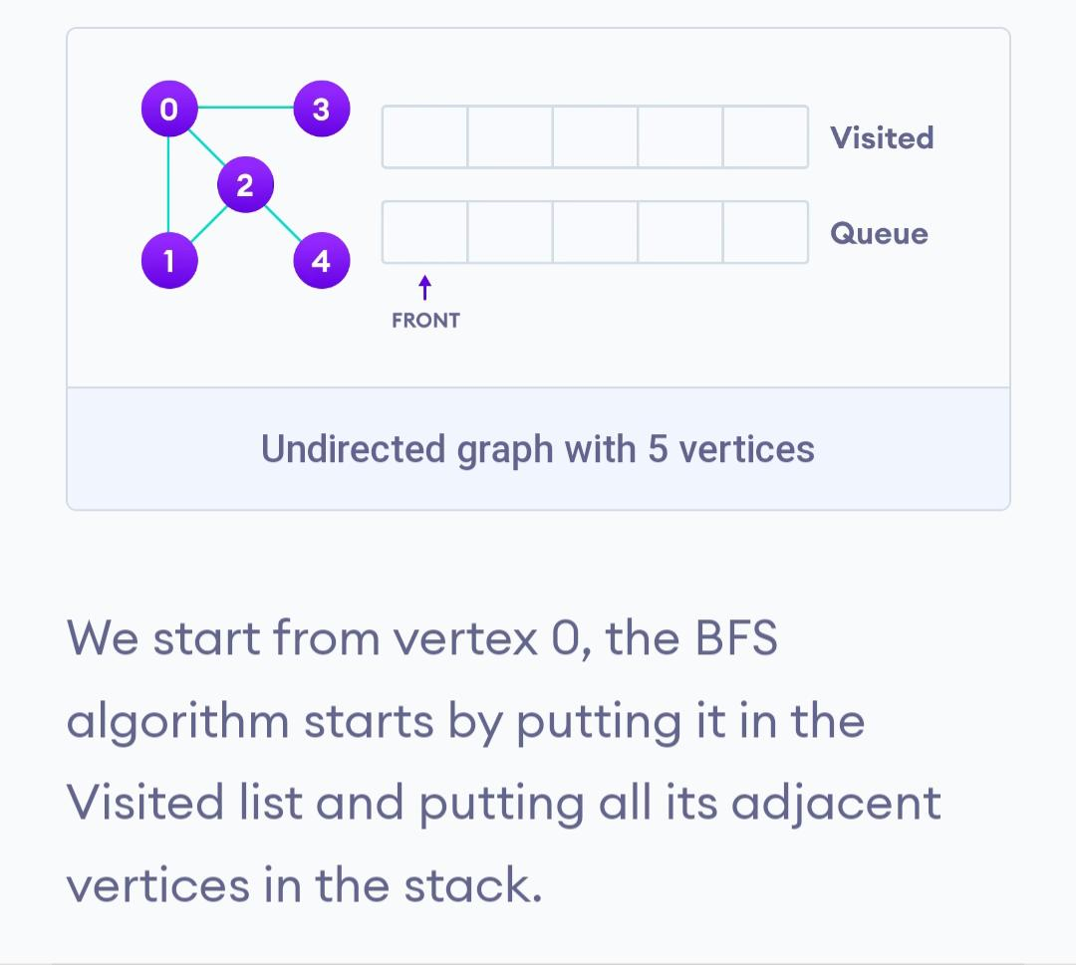
Bfs

Slide 19
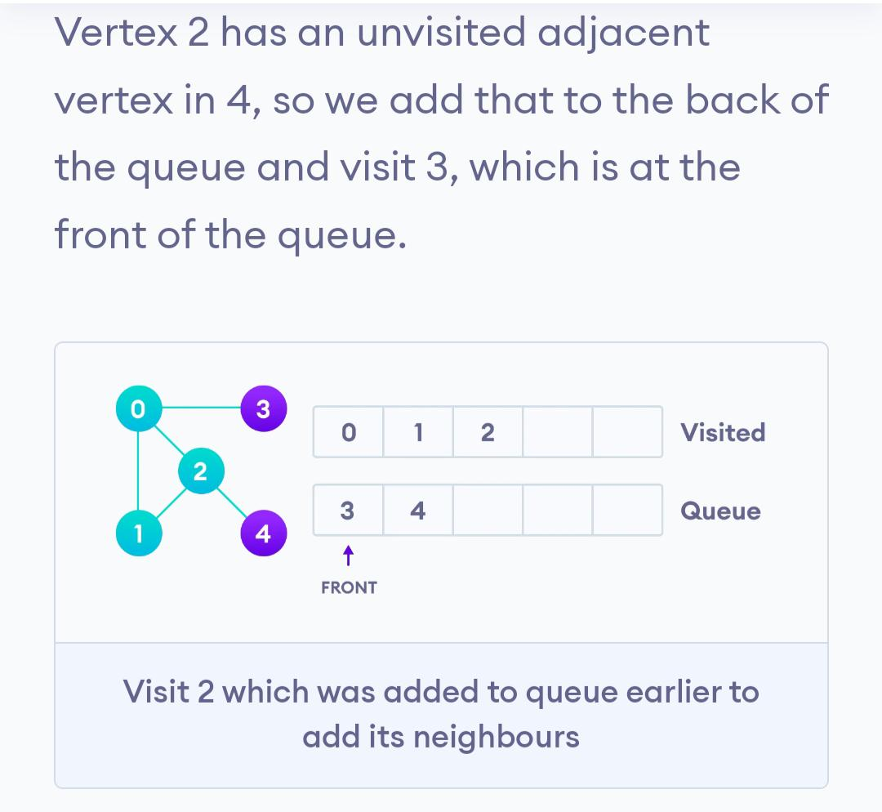
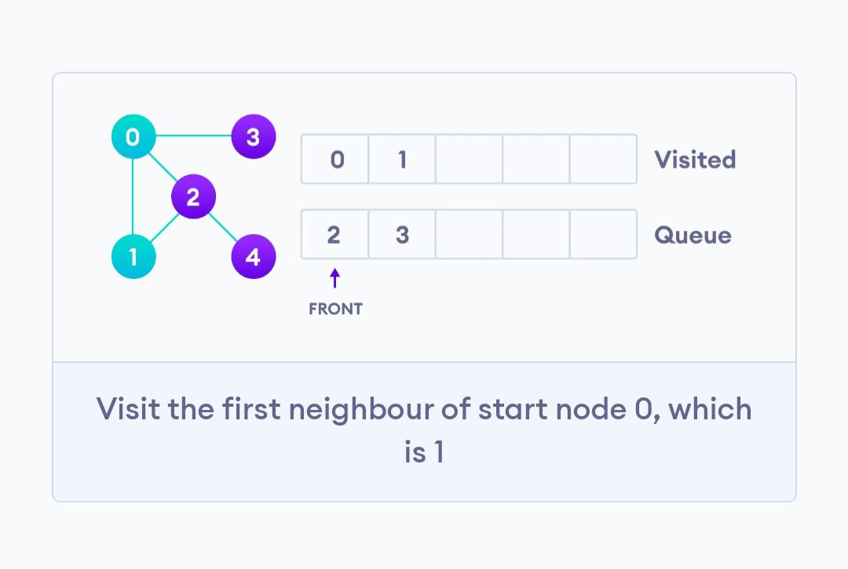

Slide 20
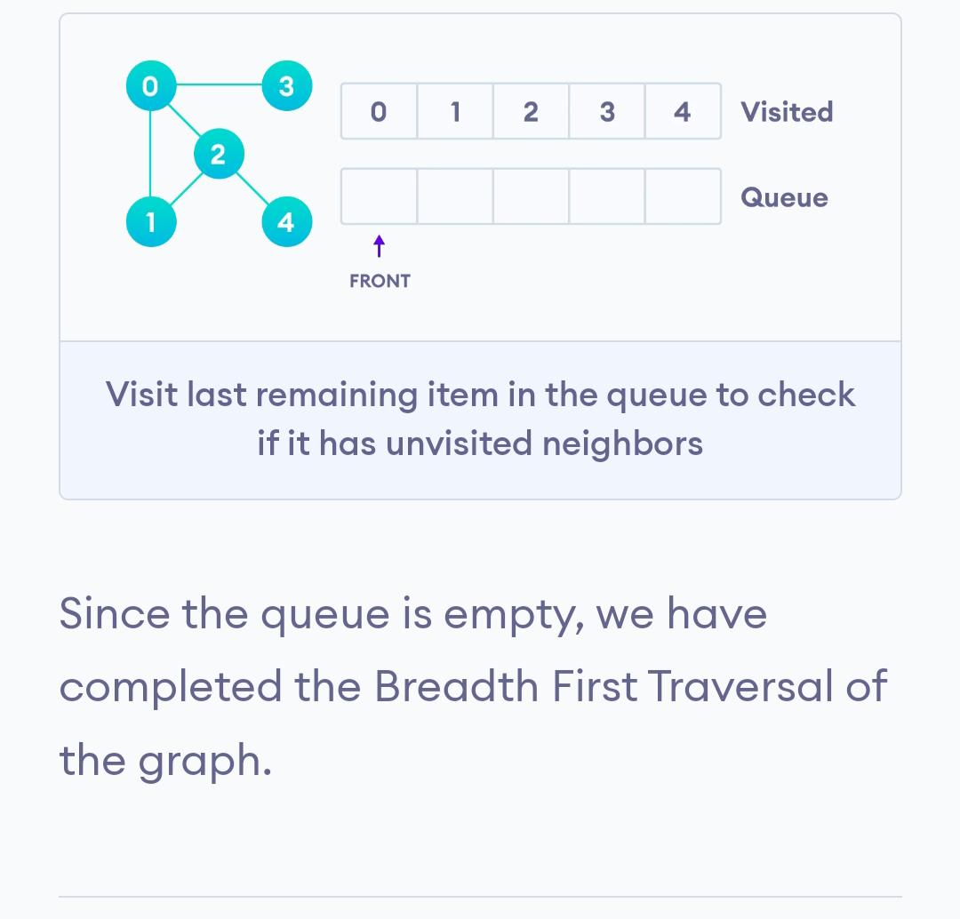
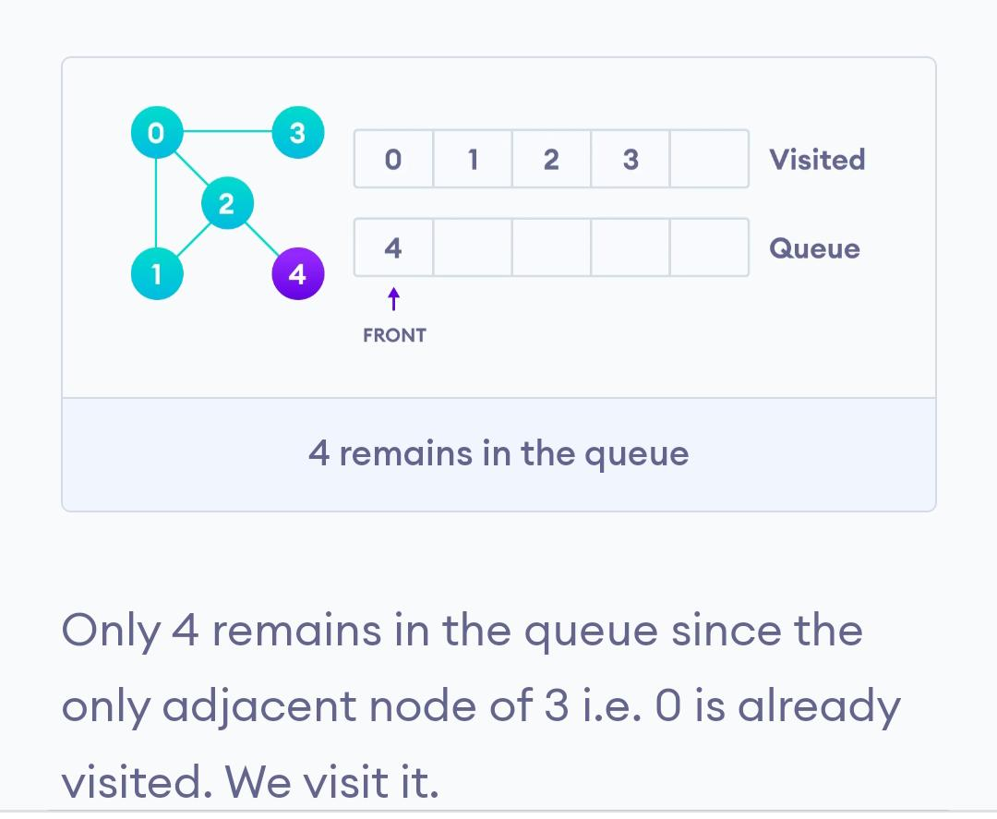

Slide 21
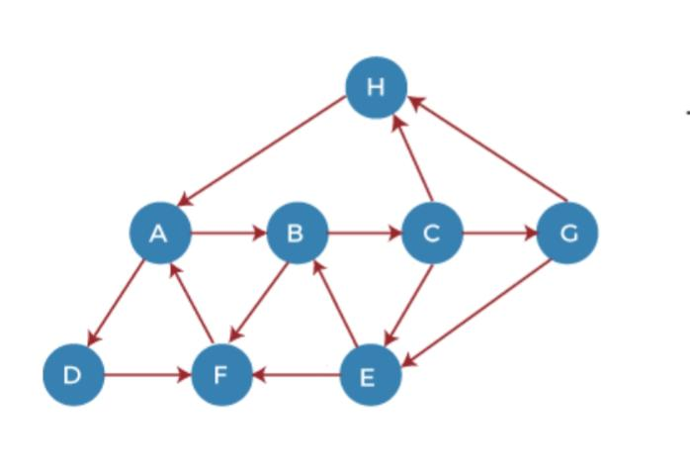
Traversing a Graph-Depth First Search.
HADFBCGE

Slide 22
DFS
Step 1 – First, push H onto the stack.
Step 2 – POP the top element from the stack, i.e., H, and print it. Now, PUSH all the neighbors of H onto the stack that are in ready state.
Step 3 - POP the top element from the stack, i.e., A, and print it. Now, PUSH all the neighbors of A onto the stack that are in ready state.
Step 4 - POP the top element from the stack, i.e., D, and print it. Now, PUSH all the neighbors of D onto the stack that are in ready state.
Step 5 - POP the top element from the stack, i.e., F, and print it. Now, PUSH all the neighbors of F onto the stack that are in ready state.
Step 6 - POP the top element from the stack, i.e., B, and print it. Now, PUSH all the neighbors of B onto the stack that are in ready state.
Step 7 - POP the top element from the stack, i.e., C, and print it. Now, PUSH all the neighbors of C onto the stack that are in ready state.
Step 8 - POP the top element from the stack, i.e., G and PUSH all the neighbors of G onto the stack that are in ready state.
Step 9 - POP the top element from the stack, i.e., E and PUSH all the neighbors of E onto the stack that are in ready state.

Slide 23
Traversing a Graph-Depth First Search.
Depth-first search is an algorithm for traversing or searching tree or graph data structures. The algorithm starts at the root node (selecting some arbitrary node as the root node in the case of a graph) and explores as far as possible along each branch before backtracking

Slide 24
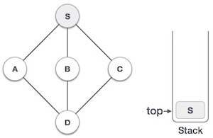
Traversing a Graph
Mark S as visited and put it onto the stack. Explore any unvisited adjacent node from S. We have three nodes and we can pick any of them. For this example, we shall take the node in an alphabetical order.

Slide 25
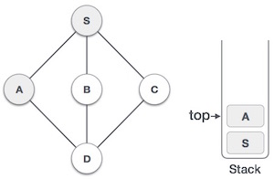
Traversing a Graph
Mark A as visited and put it onto the stack. Explore any unvisited adjacent node from A. Both S and D are adjacent to A but we are concerned for unvisited nodes only

Slide 26
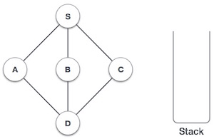
Traversing a Graph
Initialize the stack.

Slide 27
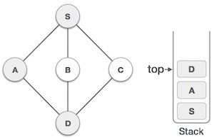
Traversing a Graph
Visit D and mark it as visited and put onto the stack. Here, we have B and C nodes, which are adjacent to D and both are unvisited. However, we shall again choose in an alphabetical order.

Slide 28
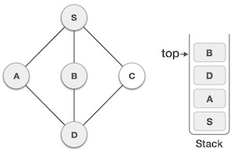
Traversing a Graph
We choose B, mark it as visited and put onto the stack. Here B does not have any unvisited adjacent node. So, we pop B from the stack

Slide 29
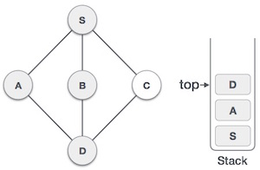
Traversing a Graph
We check the stack top for return to the previous node and check if it has any unvisited nodes. Here, we find D to be on the top of the stack.

Slide 30
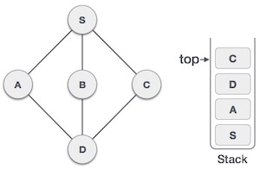
Traversing a Graph
Only unvisited adjacent node is from D is C now. So we visit C, mark it as visited and put it onto the stack

Slide 31
Spanning Tree
spanning tree can be defined as the subgraph of an undirected connected graph. It includes all the vertices along with the least possible number of edges.
If any vertex is missed, it is not a spanning tree. A spanning tree is a subset of the graph that does not have cycles, and it also cannot be disconnected.
spanning tree consists of (n-1) edges, where 'n' is the number of vertices (or nodes). Edges of the spanning tree may or may not have weights assigned to them.
All the possible spanning trees created from the given graph G would have the same number of vertices, but the number of edges in the spanning tree would be equal to the number of vertices in the given graph minus 1.

Slide 32
Spanning Tree
complete undirected graph can have n^{n-2} number of spanning trees where n is the number of vertices in the graph. Suppose, if n = 5, the number of maximum possible spanning trees would be 5⁵⁻² = 125.
spanning tree is used to find a minimum path to connect all nodes of the graph.

Slide 33
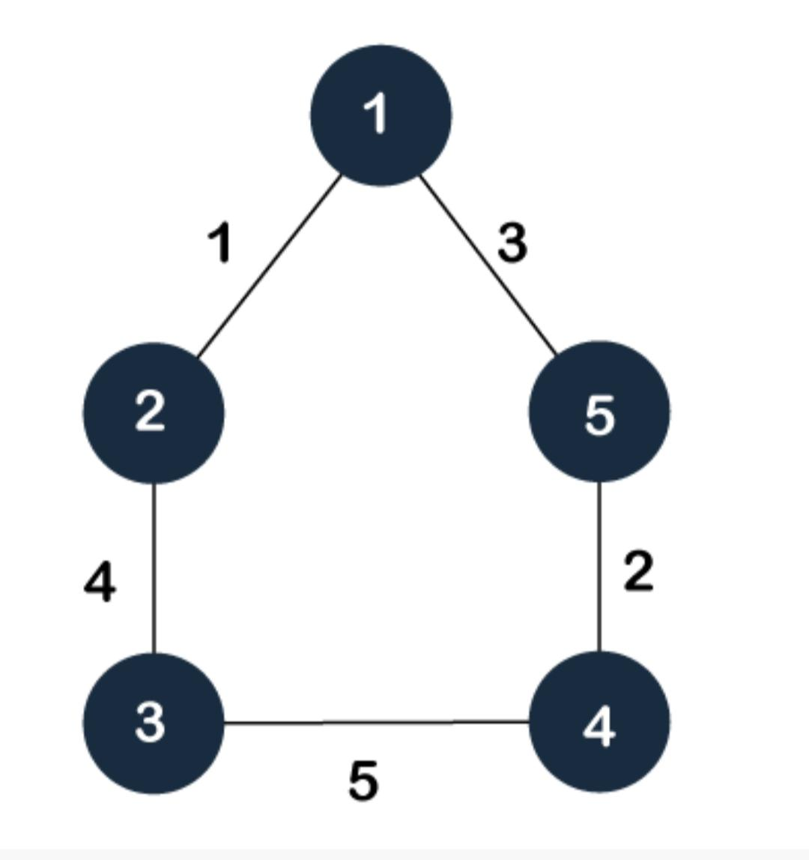
Spanning Tree

Slide 34
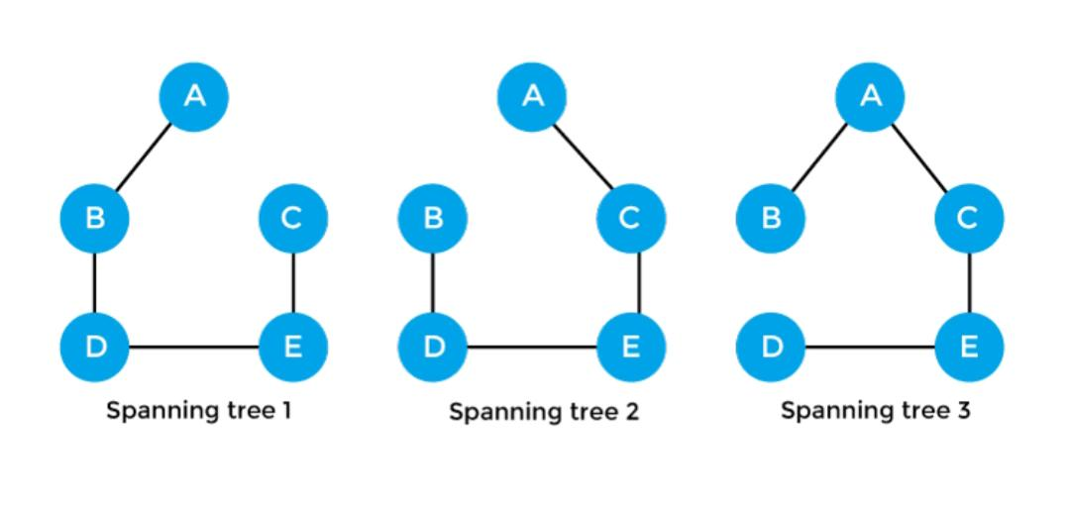
Spanning Tree

Slide 35
Properties of spanning tree
There can be more than one spanning tree of a connected graph G.
A spanning tree does not have any cycles or loop.
A spanning tree is minimally connected
There can be a maximum n^n-2 number of spanning trees that can be created from a complete graph.
there is no spanning tree of a disconnected graph.

Slide 36
Minimum Spanning Tree
minimum spanning tree can be defined as the spanning tree in which the sum of the weights of the edge is minimum.
The weight of the spanning tree is the sum of the weights given to the edges of the spanning tree.
In the real world, this weight can be considered as the distance, traffic load, congestion, or any random value.

Slide 37
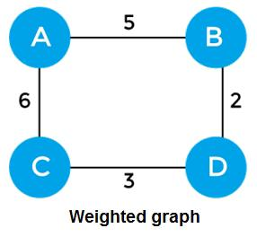
Minimum Spanning Tree
sum of the edges of the above graph is 16

Slide 38
Minimum Spanning Tree
Minimum spanning Tree should contain n vertices and n-1 edges

Slide 39
Algorithm for Minimum Spanning Tree
minimum spanning tree can be found from a weighted graph by using the algorithms given below -
Prim's Algorithm
Kruskal's Algorithm

Slide 40
Kruskals Algorithm
First, sort all the edges from low weight to high.
Now, take the edge with the lowest weight and add it to the spanning tree. If the edge to be added creates a cycle, then reject the edge.
Continue to add the edges until we reach all vertices, and a minimum spanning tree is created.

Slide 41
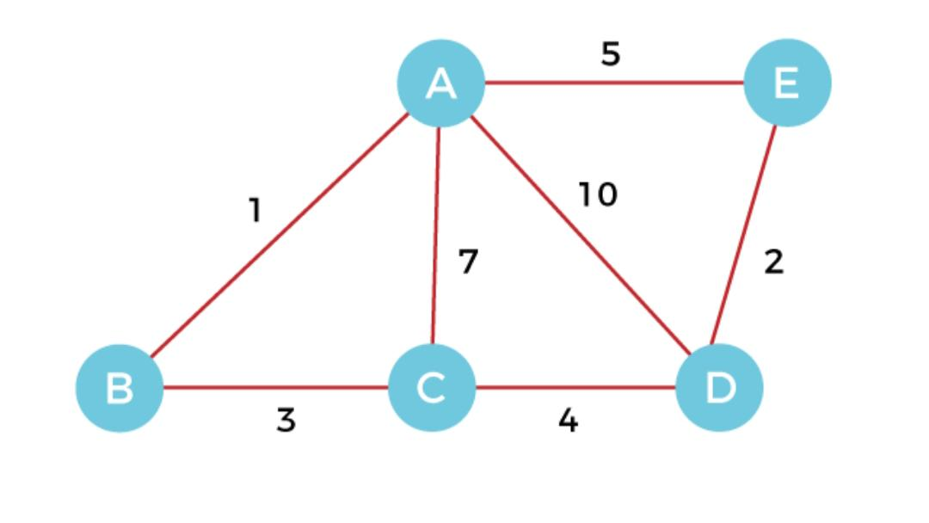
Kruskals algorithm

Slide 42
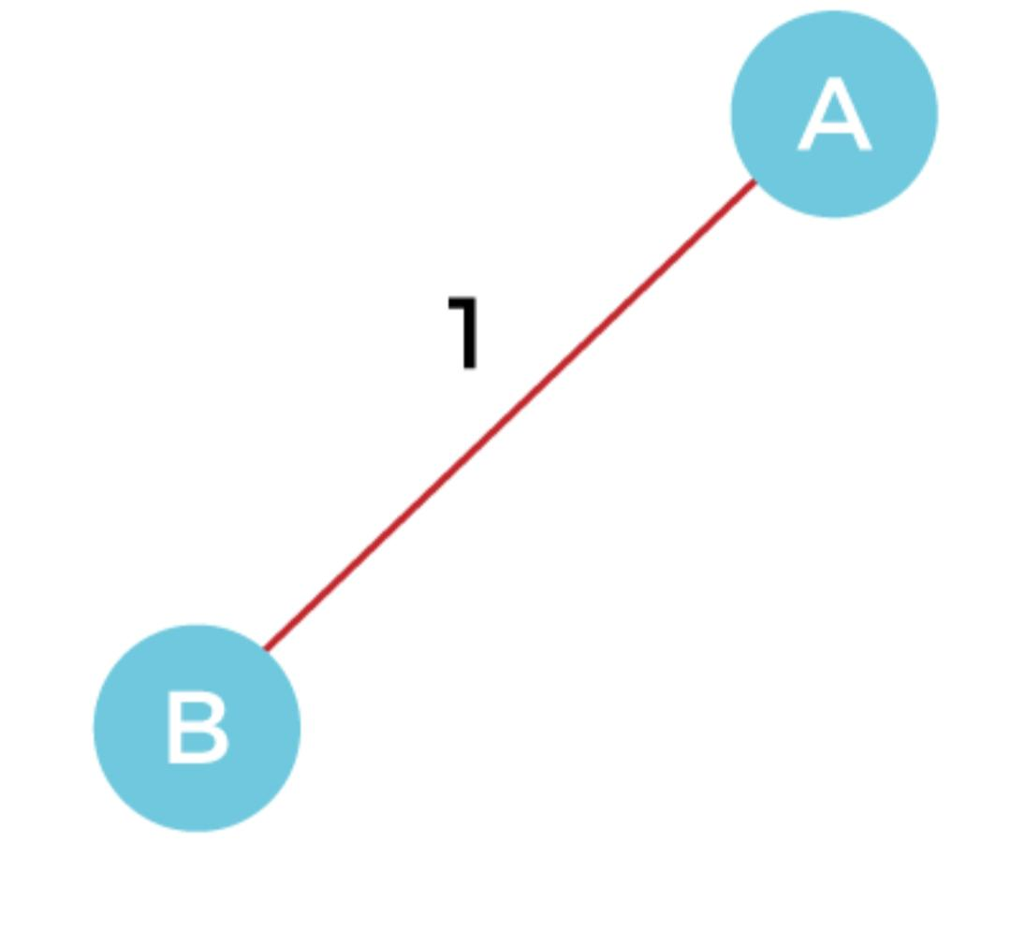
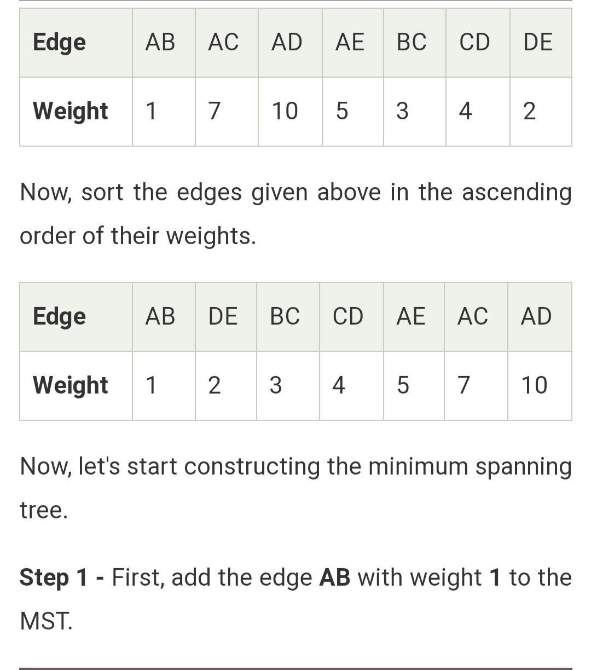

Slide 43
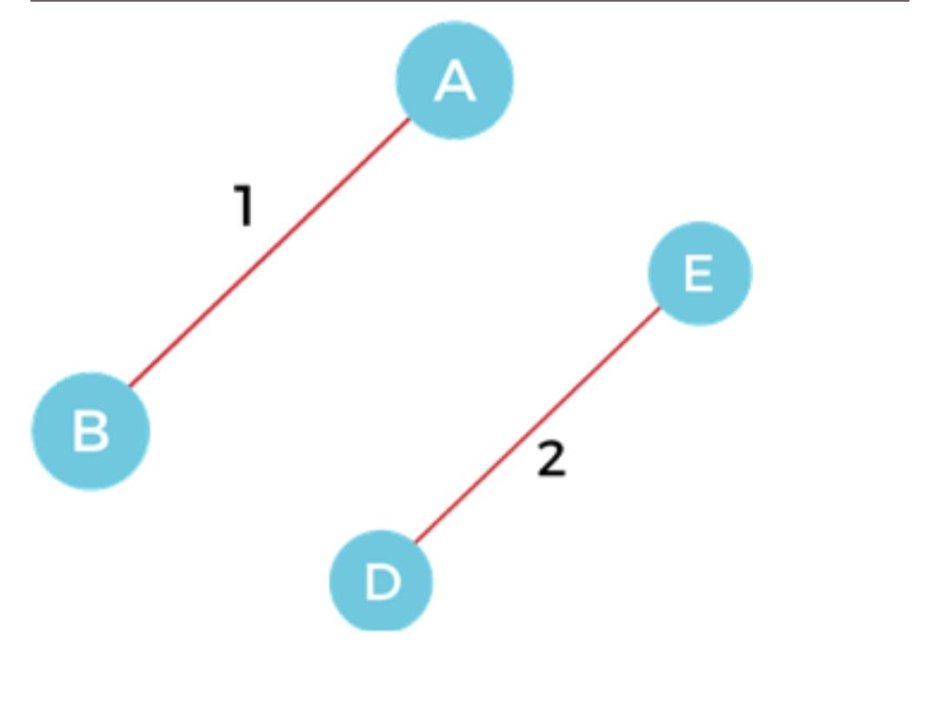
Step 2 – Add the edge DE with weight 2 to the MST as it is not creating the cycle.

Slide 44
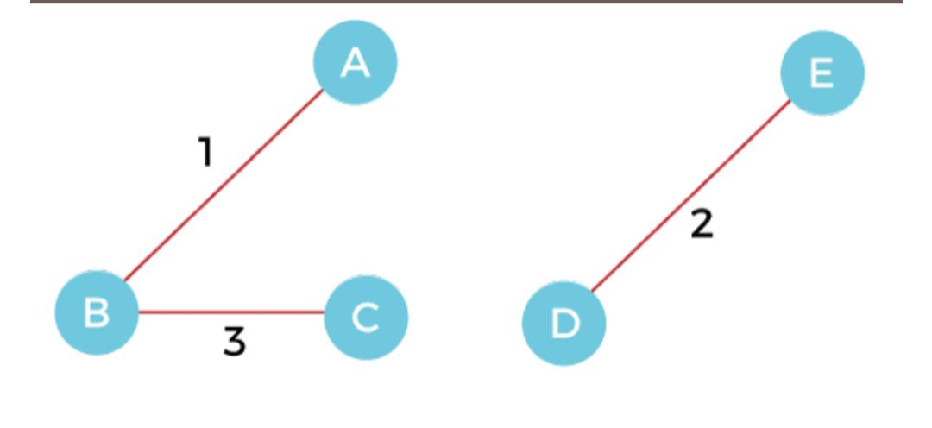
Step 3 – Add the edge BC with weight 3 to the MST, as it is not creating any cycle or loop.

Slide 45
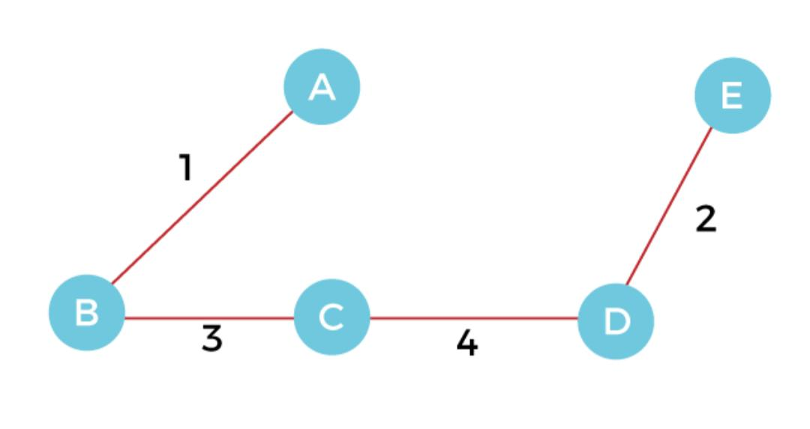
Step 4 – Now, pick the edge CD with weight 4 to the MST, as it is not forming the cycle.

Slide 46
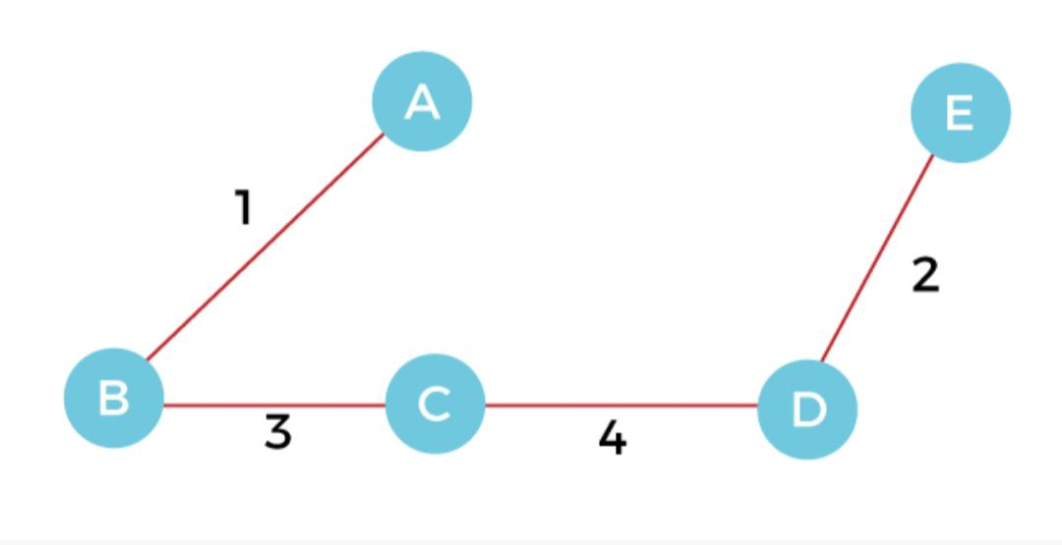
Step 5 – After that, pick the edge AE with weight 5. Including this edge will create the cycle, so discard it.
Step 6 – Pick the edge AC with weight 7. Including this edge will create the cycle, so discard it. Step 7 – Pick the edge AD with weight 10. Including this edge will also create the cycle, so discard it.

Slide 47
Cost of the MST is = AB + DE + BC + CD = 1 + 2 + 3 + 4 = 10.

Slide 48
Prims algorithm
Prim's Algorithm is a greedy algorithm that is used to find the minimum spanning tree from a graph.
Prim's algorithm finds the subset of edges that includes every vertex of the graph such that the sum of the weights of the edges can be minimized.
Prim’s algorithm starts with the single node and explores all the adjacent nodes with all the connecting edges at every step.
The edges with the minimal weights causing no cycles in the graph got selected.

Slide 49
Prims algorithm
First, we have to initialize an MST with the randomly chosen vertex. Now, we have to find all the edges that connect the tree in the above step with the new vertices. From the edges found, select the minimum edge and add it to the tree. Repeat step 2 until the minimum spanning tree is formed.

Slide 50
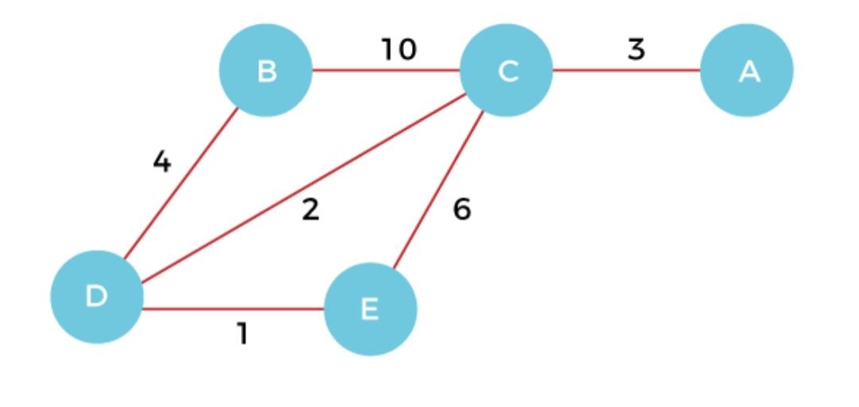
Prims algorithm

Slide 51
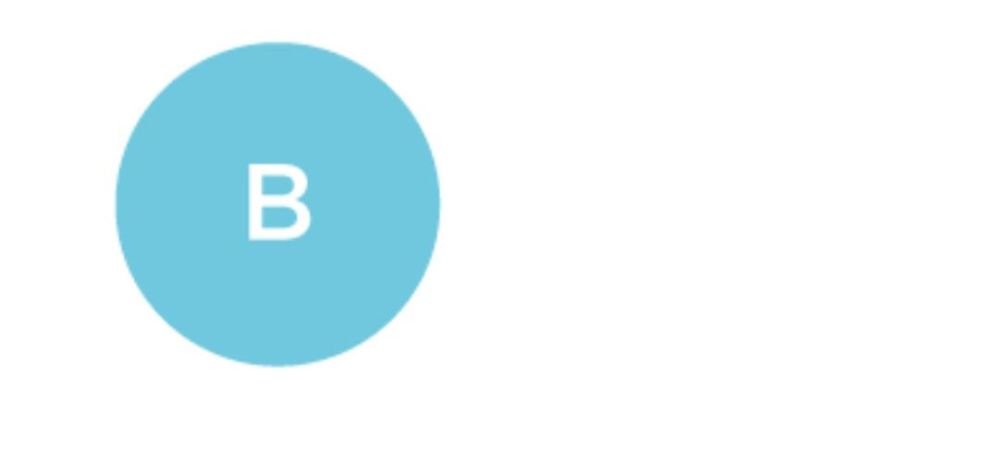
Step 1 – First, we have to choose a vertex from the above graph. Let’s choose B.

Slide 52
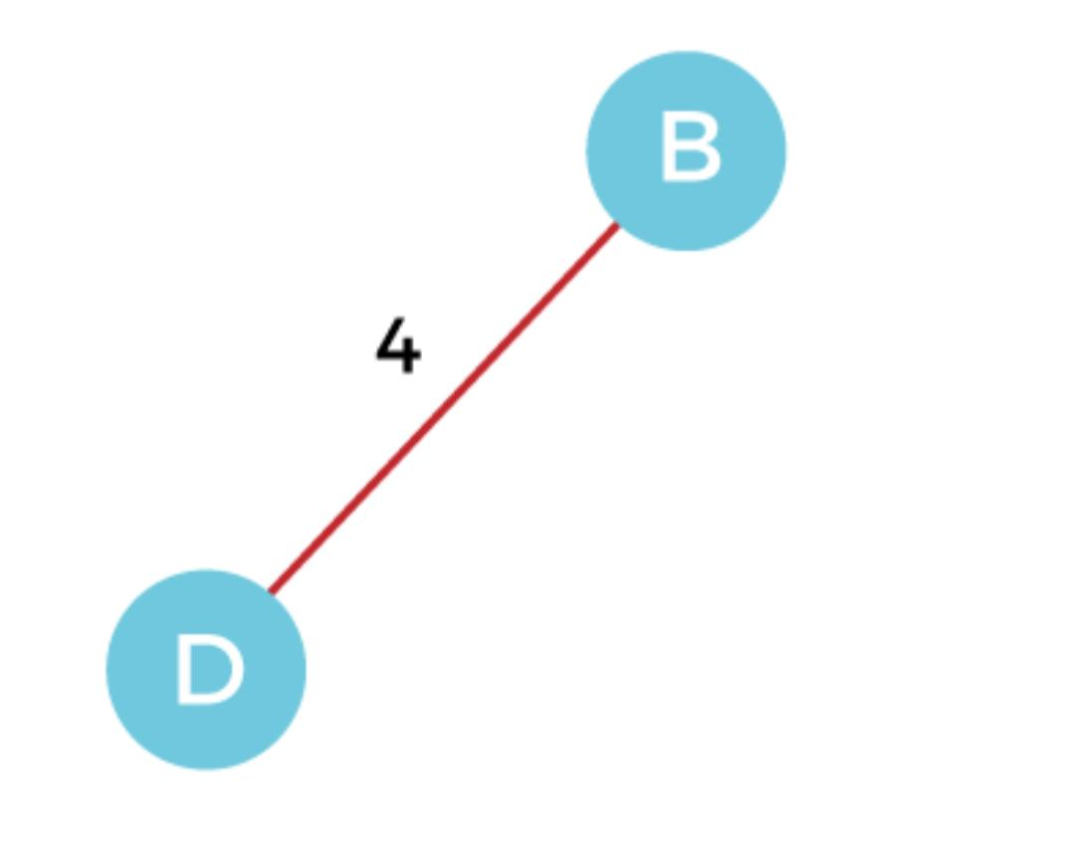
Step 2 – Now, we have to choose and add the shortest edge from vertex B. There are two edges from vertex B that are B to C with weight 10 and edge B to D with weight 4. Among the edges, the edge BD has the minimum weight. So, add it to the MST.

Slide 53
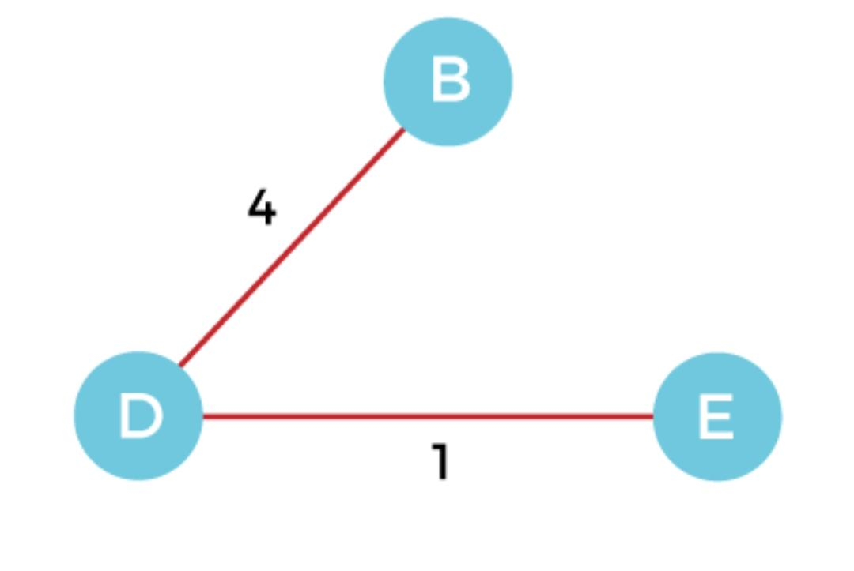
Step 3 – Now, again, choose the edge with the minimum weight among all the other edges. In this case, the edges DE and CD are such edges. Add them to MST and explore the adjacent of C, i.e., E and A. So, select the edge DE and add it to the MST.

Slide 54
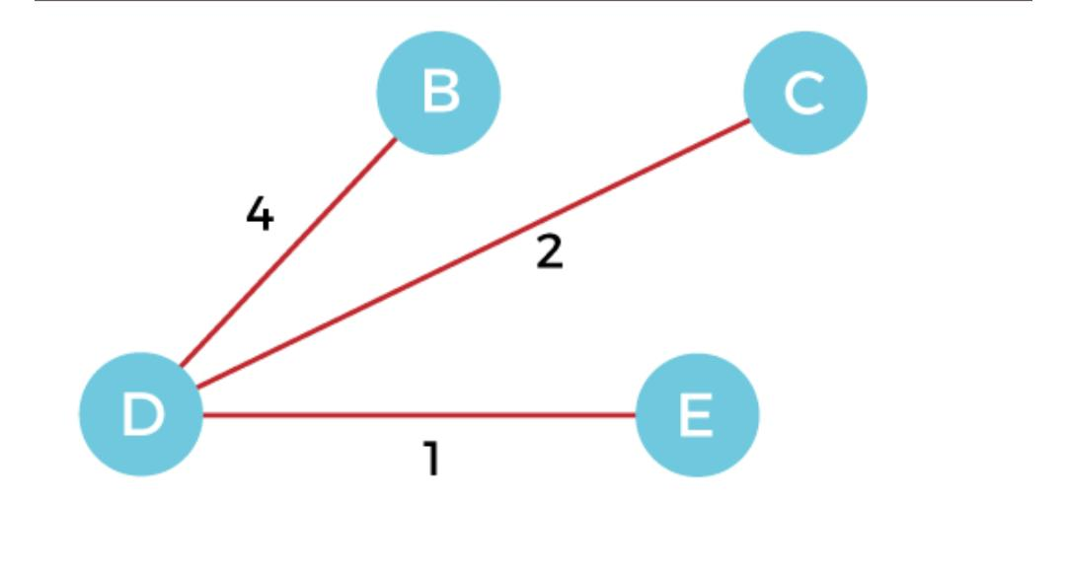
Step 4 – Now, select the edge CD, and add it to the MST.

Slide 55
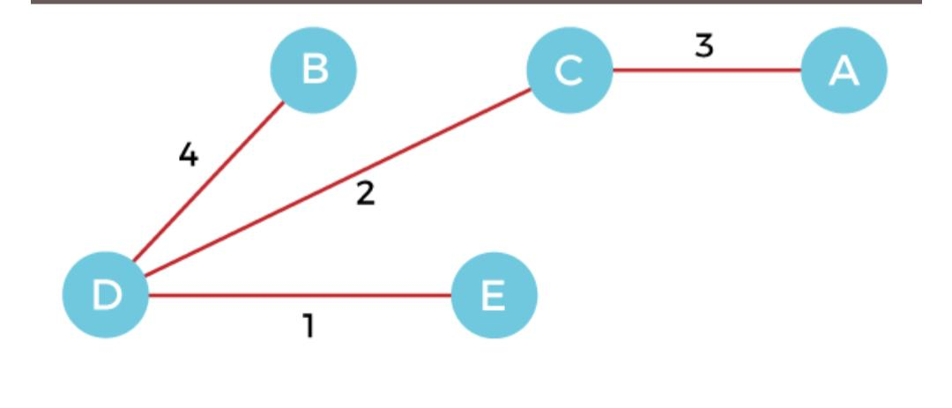
Step 5 - Now, choose the edge CA. Here, we cannot select the edge CE as it would create a cycle to the graph. So, choose the edge CA and add it to the MST.

Slide 56
The graph produced in step 5 is the minimum spanning tree of the given graph. The cost of the MST is given below – Cost of MST = 4 + 2 + 1 + 3 = 10 units.

